Slide 1
Used Car Value Prediction Using a Neural Network

Slide 2
Introduction
Me: Allison Casey
Senior Application Support Engineer at Billtrust
BS TAM from University of Colorado, Boulder
MSDA Student at WGU

Slide 3
Problem & Hypothesis
Since cars depreciate over time it is common for consumers to buy used cars as well as for dealers to sell used cars. As a result, it is beneficial to both buyers and sellers of used cars to be able to accurately determine the value for a used car.
Can an accurate neural network model be constructed using the used car data?
Null Hypothesis: An accurate predictive neural network model (accuracy less than 80%) cannot be constructed using the data set
Alternate Hypothesis: An accurate predictive neural network model (accuracy of 80% or higher) can be constructed using the data set

Slide 4
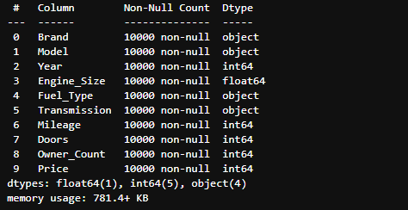
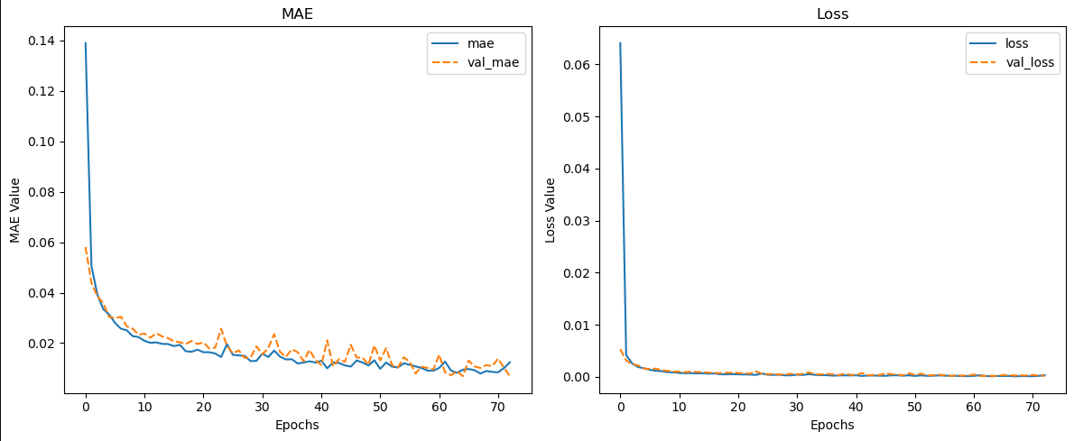
Data Analysis Process
Extract, explore, and clean the data set
Prepare the data for analysis
One hot encoding
Scaling
Splitting the data into training and test sets
Build the model
Keras Functional API
Train the model
Early stopping monitor
Evaluate the model

Slide 5
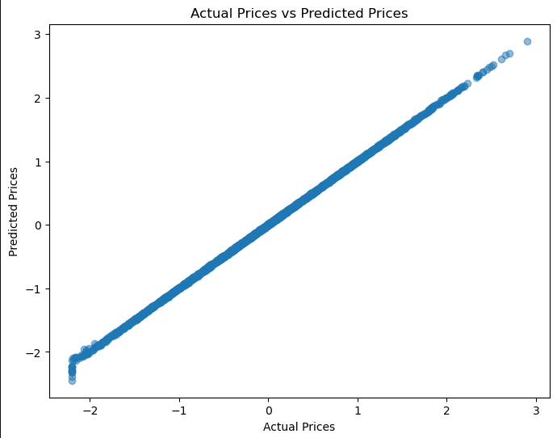
Findings
The results show that the null hypothesis can be rejected, and a model with greater than 80% accuracy can be created. Since regression models don't have accuracy in the same way that a classification model does, the accuracy, in this case, is defined by how well the model explains the variance in the target variable, so the R² value, which was calculated as .9998 or approximately 99% using the test data.

Slide 6
Limitations
One hot encoding - Increases the dimensionality of the data, which, in this case, could result in overfitting and greater computational resource consumption.
Scaling - model output less interpretable than original values
Splitting the data - limits the testing and training data.
Keras Functional API model - more complicated to interpret than other methods
Early stopping monitor - Training could be stopped prematurely
Overfitting?

Slide 7
Proposed Actions
Start using the model!
Compare to existing methods
Gather more data and do more training
Create other models for comparison
Random forest
Linear regression

Slide 8
Benefits
The expected benefits of the study would be the ability to accurately predict car values for buyers and sellers to maximize profit for sellers and help buyers not spend too much on a used car.

Slide 9
THANK YOU
Sources
Elleh, Festus. “Advanced Data Analytics - Task 1.” D213 Task 2 Cohort Webinar. 2025.
“ReLU Activation Function in Deep Learning.” GeeksforGeeks, GeeksforGeeks, 29 Jan. 2025, www.geeksforgeeks.org/relu-activation-function-in-deep-learning/.
Team, Keras. “Keras Documentation: Earlystopping.” Keras, keras.io/api/callbacks/early_stopping/. Accessed 11 Mar. 2025.
Team, Keras. “Keras Documentation: The Functional Api.” Keras, keras.io/guides/functional_api/#training-evaluation-and-inference. Accessed 11 Mar. 2025.
Allison Casey
acas857@wgu.edu

